Slide 1
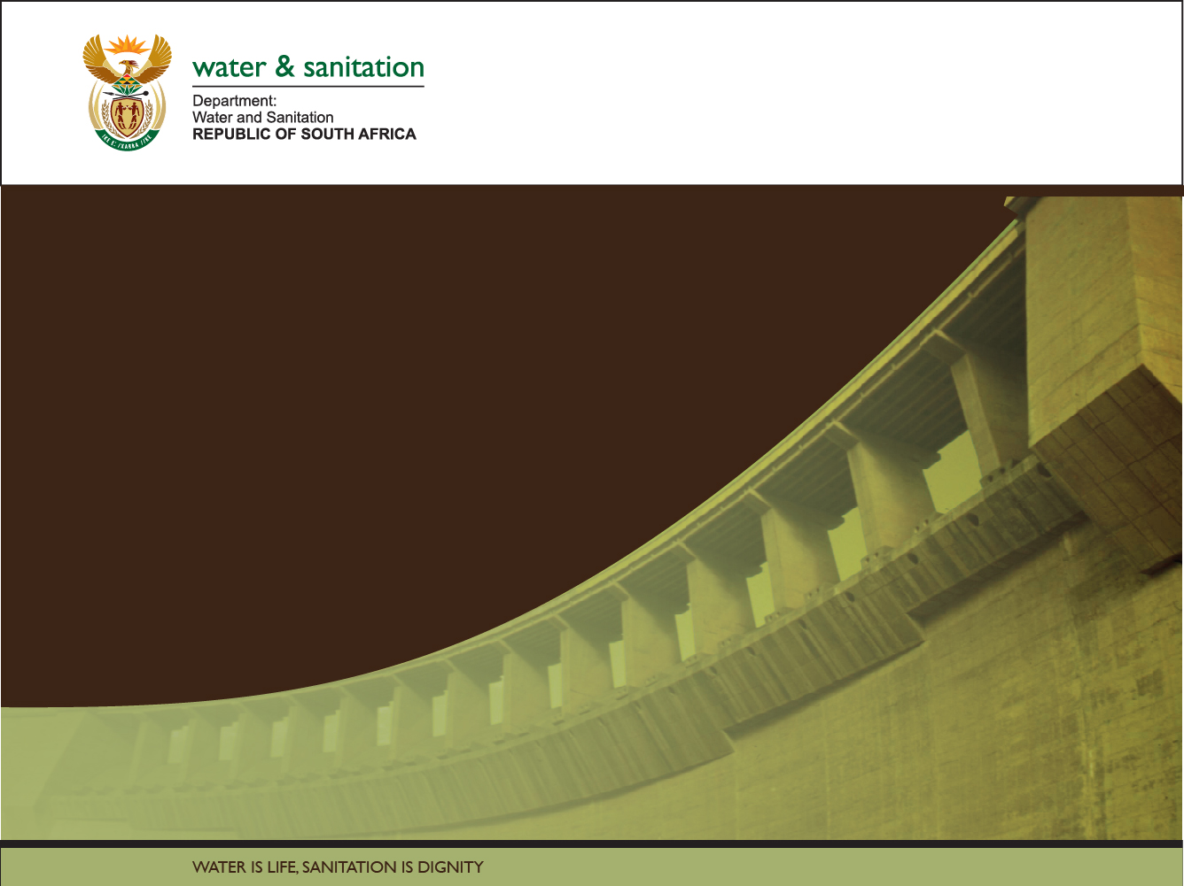

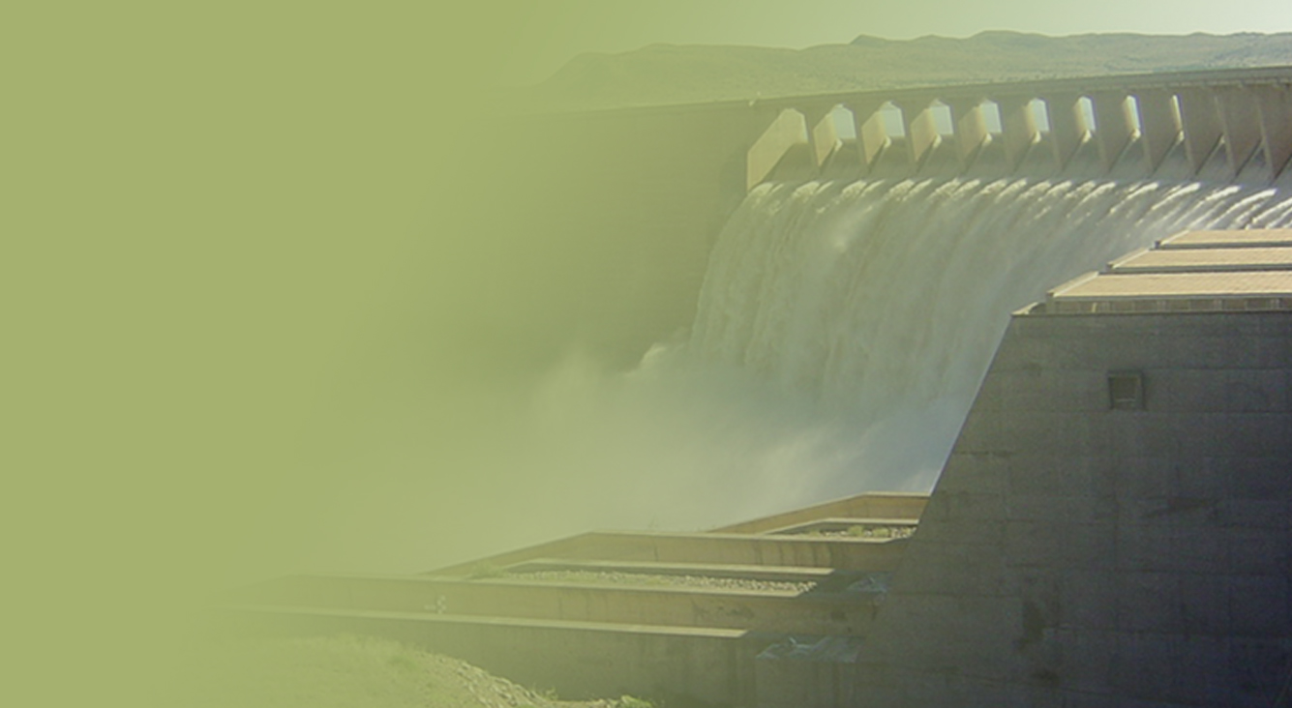
The Determination of Water Resources Classes and Resource Quality Objectives in the Breede-Gouritz WMA
TTG 2
Presented by: Louise Lodenkemper
Date: 13 March 2018
Venue: Robertson

Slide 2
Overview
Prioritised wetland per IUA
  Ecological Importance
  Provision of Ecosystem Services supply/demand (INR, 2017)
Component/Sub-component
  i.e. Quantity/Flow
Indicator
  Representation of trend tracking the measurable change in a system over time. Focuses on a small manageable set of information to get a sense of the “bigger picture”
RQO
  Descriptive broad statements describing overall objectives for the Resource Unit
Numerical limit
  Quantitative descriptors of different components of the Resource Unit

Slide 3
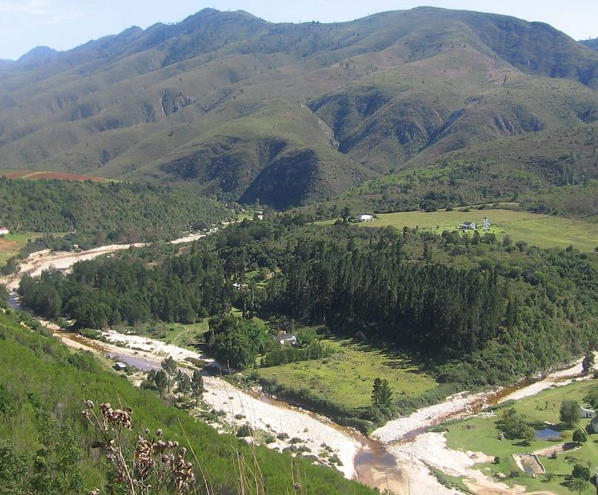

Methodology for Determination of RQOs
Priority wetlands in the Breede-Overberg
Notes:
Erik and team to present the methodology used for scenario evaluation

Slide 4
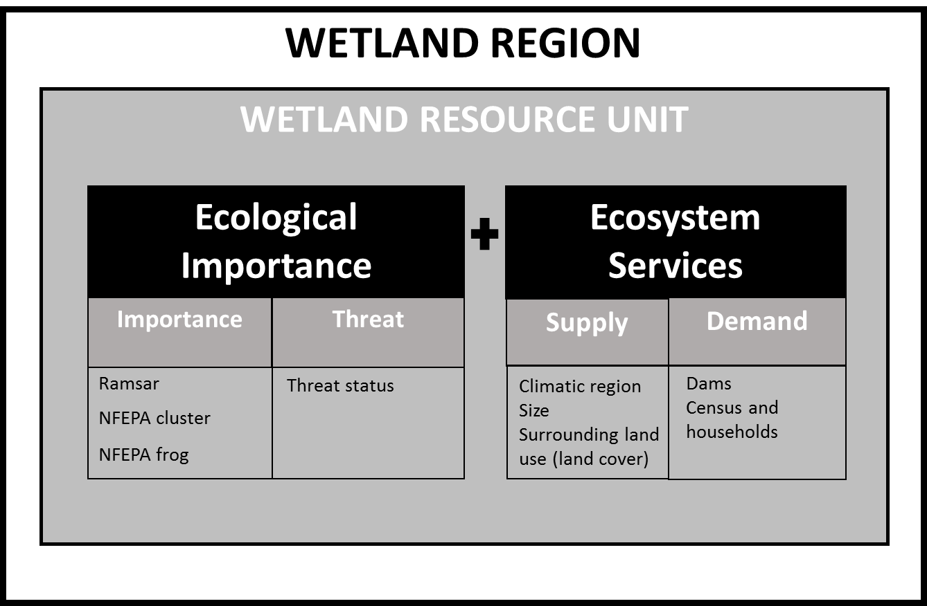
Identification of Priority Wetlands
Important wetlands include those that have ecological importance for maintenance of biodiversity ecosystem integrity, as well as those that provide ecosystem services.
z
Notes:
The Status Quo report defined the Wetland Regions within the study area according to the spatial framework of Ecoregions. Nested within Wetland Regions are the Wetland Resource Units, defined by vegetation type and Hydrogeomorphic (HGM) unit and prioritised according to Ecological Importance and Ecosystem Services. As the HGM unit is defined by landform it is important to understand the location of a wetland in the landscape and the underlying geological controls.
From an RDM perspective, important wetlands include those that have both ecological importance for the maintenance of biodiversity ecosystem integrity, as well as those that provide ecosystem services. In terms of ecosystem services, wetland prioritisation needs to consider both the ability of a wetland to provide services as well as the demand for such services within the catchment. These two aspects define the importance of wetlands in terms of ecosystem services.

Slide 5
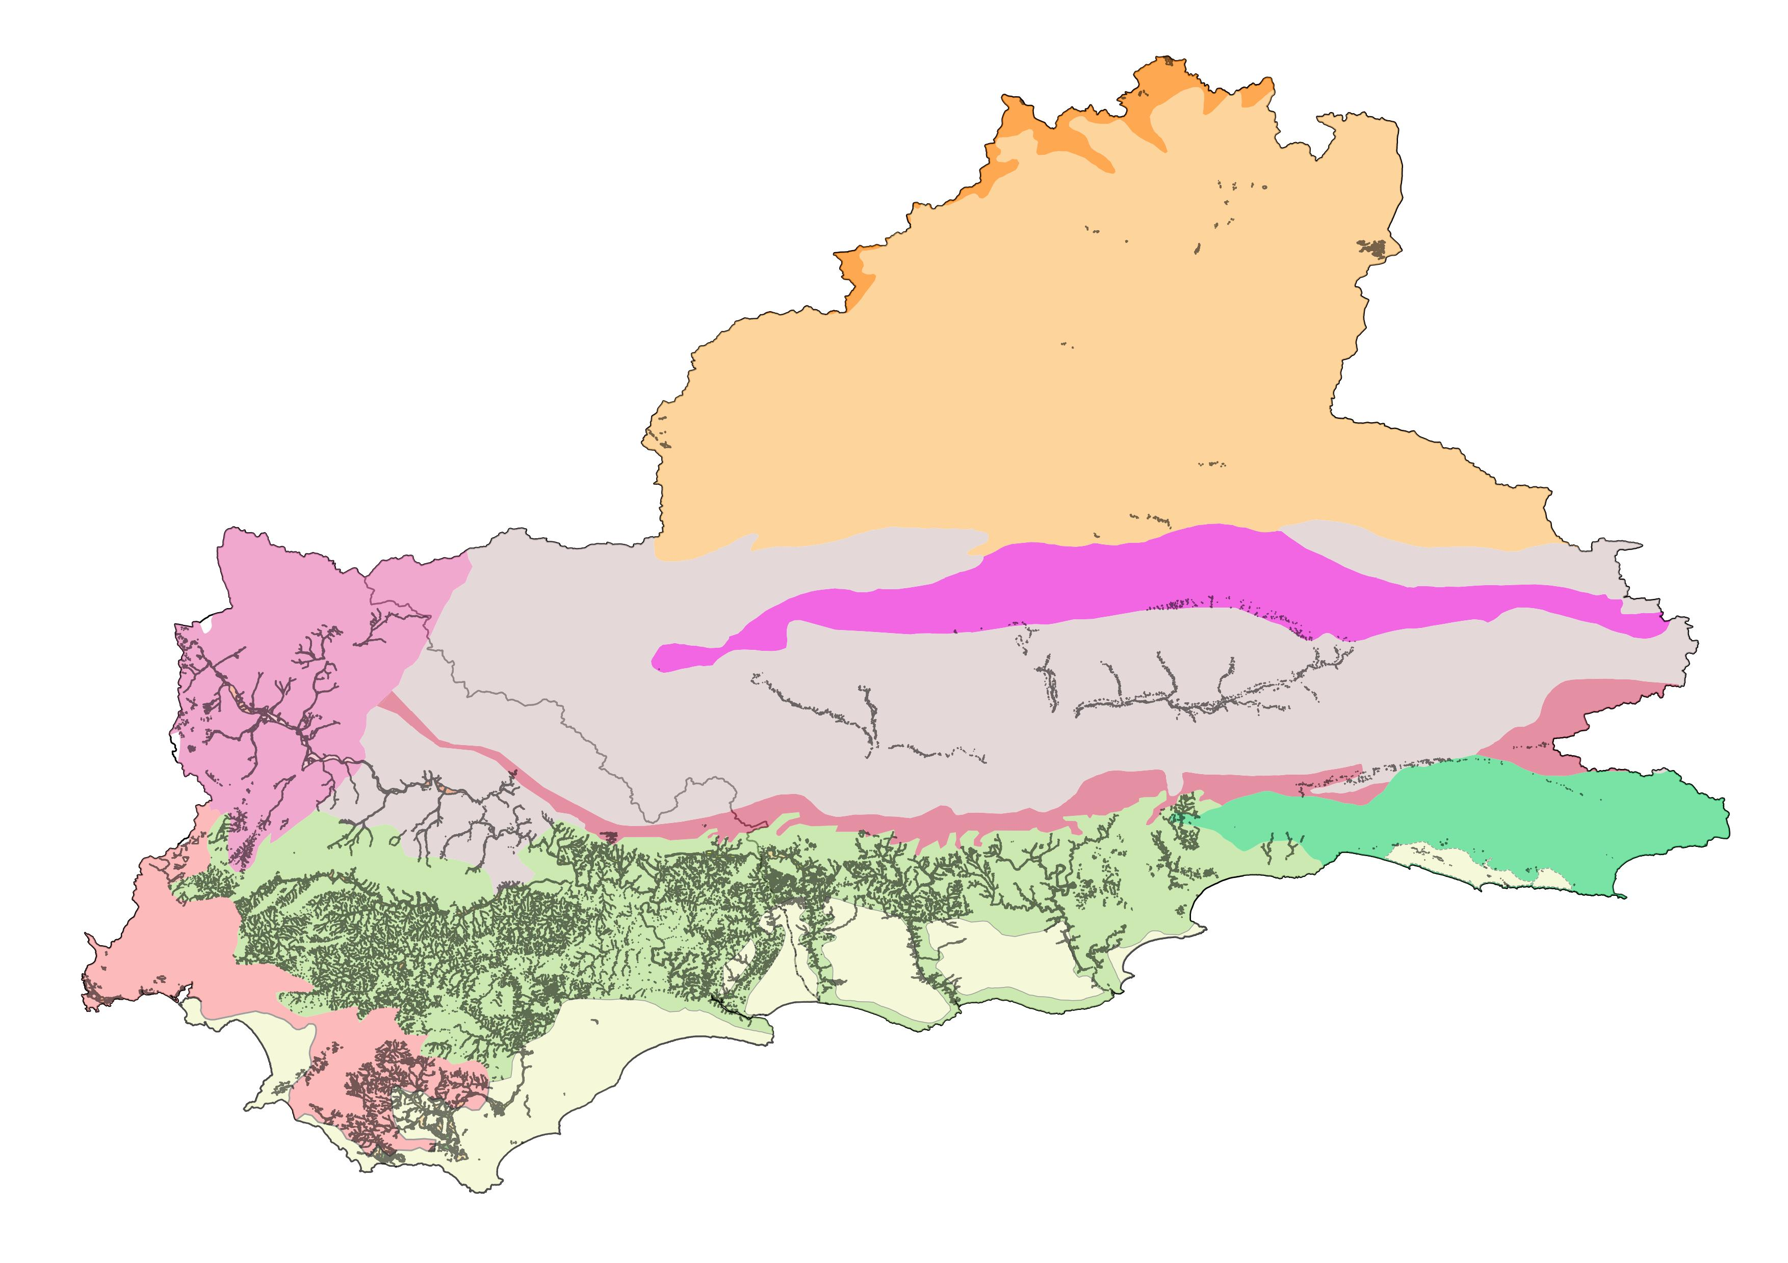
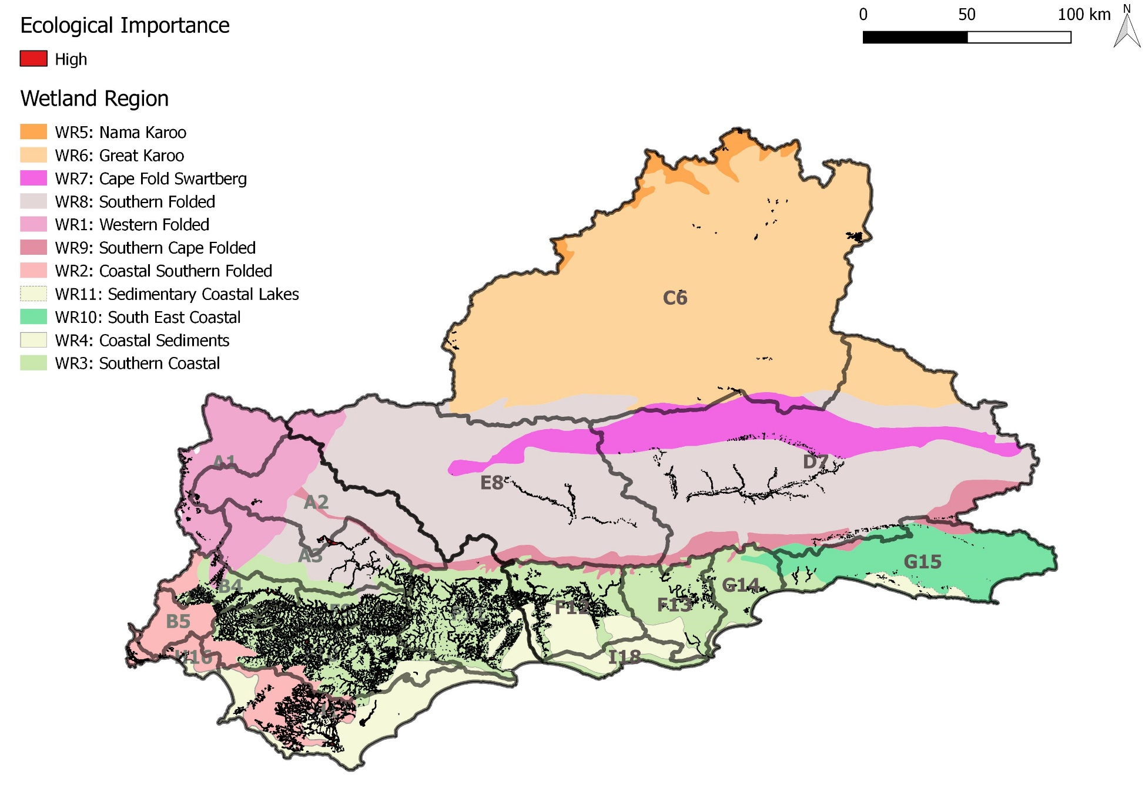
Wetland Regions have typical wetland types
  Typically small seeps and river-linked wetlands
  Typically seeps with a likely high degree of groundwater dependence
  Typically small seeps and river-linked wetlands with a likely high degree of direct and indirect groundwater dependence
Typically small seeps associated with groundwater-fed springs
  Typically seeps and depressions as well as river-linked wetlands
  Typically valley bottom and floodplain wetlands
  Typically valley-bottom wetlands and seepage wetlands
  Typically lakes and wetland flats
  Typically seeps and depression wetlands as well as valley bottom and floodplain wetlands
  Typically valley bottom wetlands
Wetlands are infrequent, possibly due to deep infiltrating soils and a lack of shallow/perched water tables. Inter-dune depressional wetlands and present suggesting groundwater contributions

Slide 6
Ecologically Important Wetlands
 |  | Threat
 |  | High | Low
Ecological Importance | High | Implement restoration and rehabilitation to conserve ecologically important areas that are under threat. | Retain low current threat and possible future threat in ecological important areas.
 | Low | Areas of least concern | Areas of least concern
Different high scores for different Wetland Regions
 | Importance |  |  | Threat
Wetland Region | NFEPA cluster | NFEPA frogs | Ramsar | Critically endangered | Endangered | Vulnerable | Least Threatened | Score
Western Folded Wetland Region (WR1) | x |  |  |  | x |  |  | 1.05
 |  |  |  | x |  |  |  | 1.0
 | x |  |  |  |  | x |  | 0.6
Coastal Southern Folded Wetland Region (WR2) | x | x |  | x |  |  |  | 1.5
 | x | /x |  |  | x |  |  | 1.3
 | x | x |  | x |  |  |  | 1.25
Nama Karoo Wetland Region (WR5) | x |  |  |  |  |  | x | 0.25
Great Karoo Wetland Region (WR6) | x |  |  |  |  |  | x | 0.25

Slide 8
Provision of Ecosystem Services
 |  | Supply
 |  | High | Low
Demand | High | Retain to meet current demand. Implement management action to limit impact of heavy demand and ensure continued supply. | Implement restoration and rehabilitation to help meet current demand.
 | Low | Retain to meet low current and possible future demand. | Areas of least concern
Ecosystem services:
Regulating and supporting benefits | Flood attenuation |  | The spreading out and slowing down of floodwater in the wetland, thereby reducing the severity of floods downstream
 | Streamflow regulation |  | Sustaining streamflow during low flow periods
 | Water quality enhancement benefits | Sediment trapping | The trapping and retention in the wetland of sediment carried by runoff waters
 |  | Phosphate assimilation | Removal by the wetland of phosphates carried by runoff water
 |  | Nitrate assimilation | Removal by the wetland of nitrates carried by runoff water
 |  | Toxicant assimilation | Removal by the wetland of toxicants (e.g. metals, biocides and salts) carried by runoff water
 |  | Erosion control | Controlling of erosion at the wetland site, principally through the protection provided by vegetation
 | Carbon storage |  | The trapping of carbon by the wetland, principally as soil organic matter

Slide 9
Provision of Ecosystem Services
Identifying supply and demand for ecosystem services broadly identifies “hotspots” for regulating and supporting services provided by wetlands across the study area.
This was applied separately for the Breede-Overberg and Gouritz-Coastal regions to allow for representation.
The location and extent of different land cover types may also affect the capability of a wetland to supply ecosystem services. Some land cover types, such as commercial annual crops, may occur within a wetland and considerably diminish the ecological condition of the wetland and its ability to supply certain ecosystem services (Kotze, 2016). Other land cover types may occur in the upslope catchment of a wetland with less direct impacts.

Slide 10
Ecosystem services related to landcover:
Ecosystem service |  | Land-cover type
 |  | Natural | Dams | Crops | Alien trees¹ | Mining | Eroded | Urban infrastructure
1 | Sediment trapping & Erosion control | 1.0 | 0.8 | 0.3 | 0.8 | 0.4 | 0.2 | 0.7
2 | Phosphate, nitrate and toxicant assimilation | 1.0 | 0.8 | 0.1 | 0.6 | 0.2 | 0.2 | 0.1
3 | Flood attenuation | 1.0 | 0.8 | 0.4 | 1.1 | 0.3 | 0.4 | 0
4 | Streamflow regulation | 1.0 | 0.6 | 0.5 | 0.5 | 0.2 | 0.5 | 0
5 | Carbon storage | 1.0 | 0.6 | 0.2 | 0.6 | 0 | 0.2 | 0.2
6 | Provision of water | 1.0 | 1.1 | 0.2 | 0.2 | 0 | 0.4 | 0
7 | Harvestable resources | 1.0 | 0.5 | 0.2 | 0.3 | 0 | 0.3 | 0
8 | Cultivated foods | 0 | 0 | 1.0 | 0 | 0 | 0 | 0
Sed trapping NB
Streamflow reg NB
Provision of water NB
Maintained services
Reduced services, but still maintains sediment trapping, carbon storage & WQ amelioration
Cultivated goods NB
INR, 2017
Flood attenuation NB

Slide 11
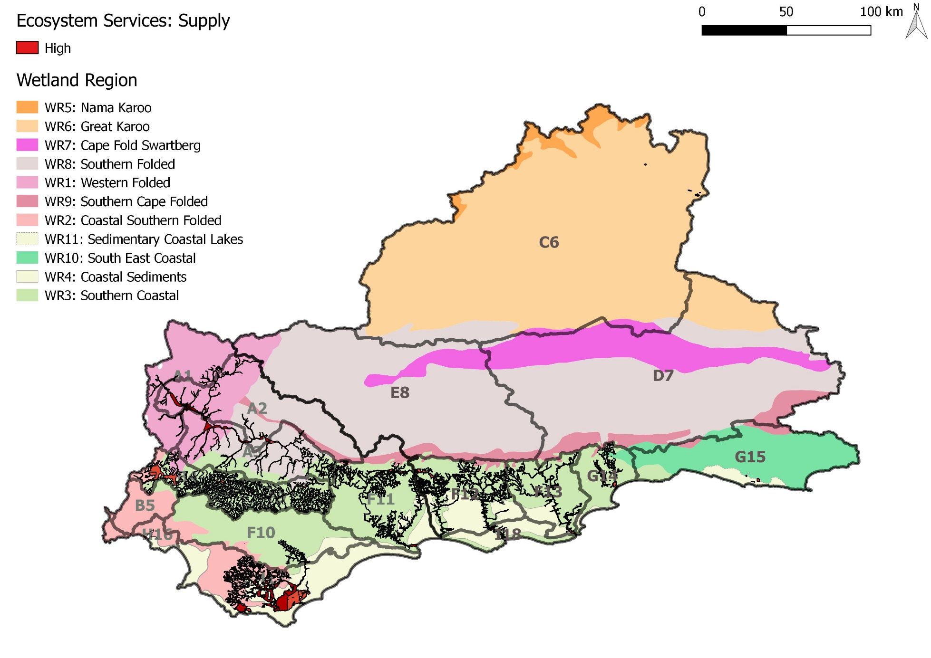

Slide 12
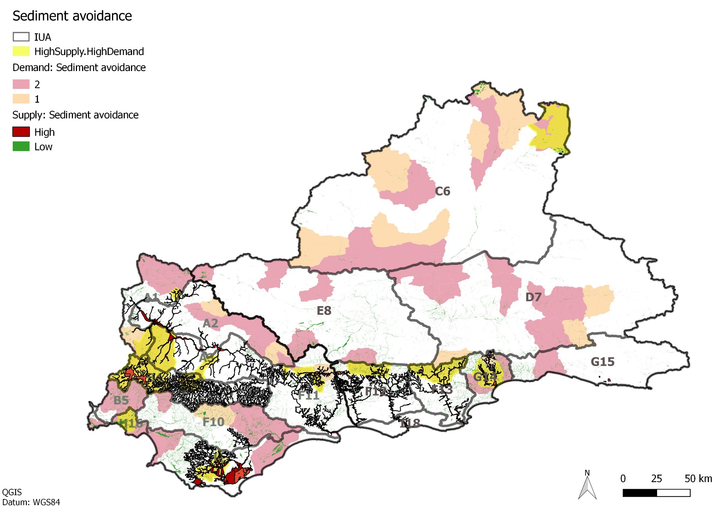

Slide 13
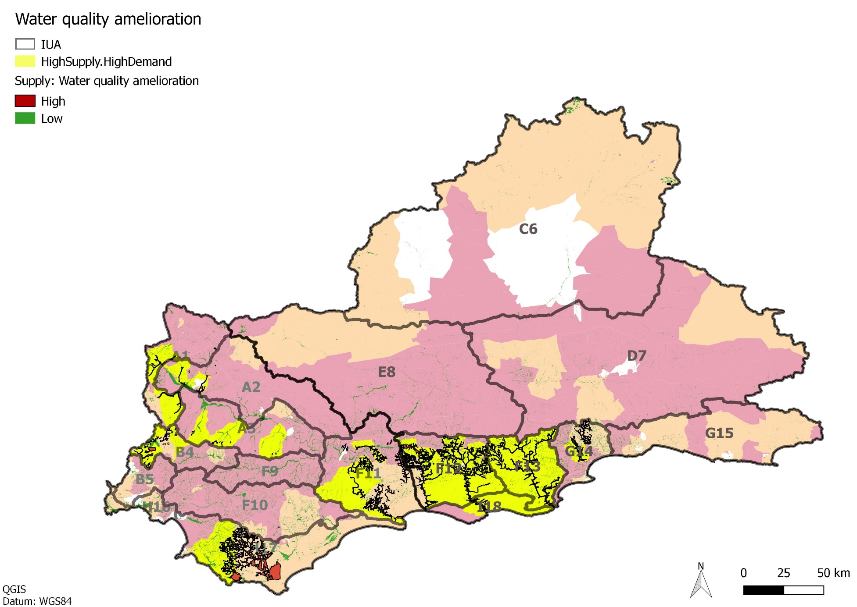

Slide 14
Integration of Importance & Supply/demand of Services
 |  | Demand.Supply
 |  | High.High | High.Low | Low.High | Low.Low
Ecological Importance. Threat | High.High
 | High.Low
 | Low.High
 | Low.Low

Slide 15
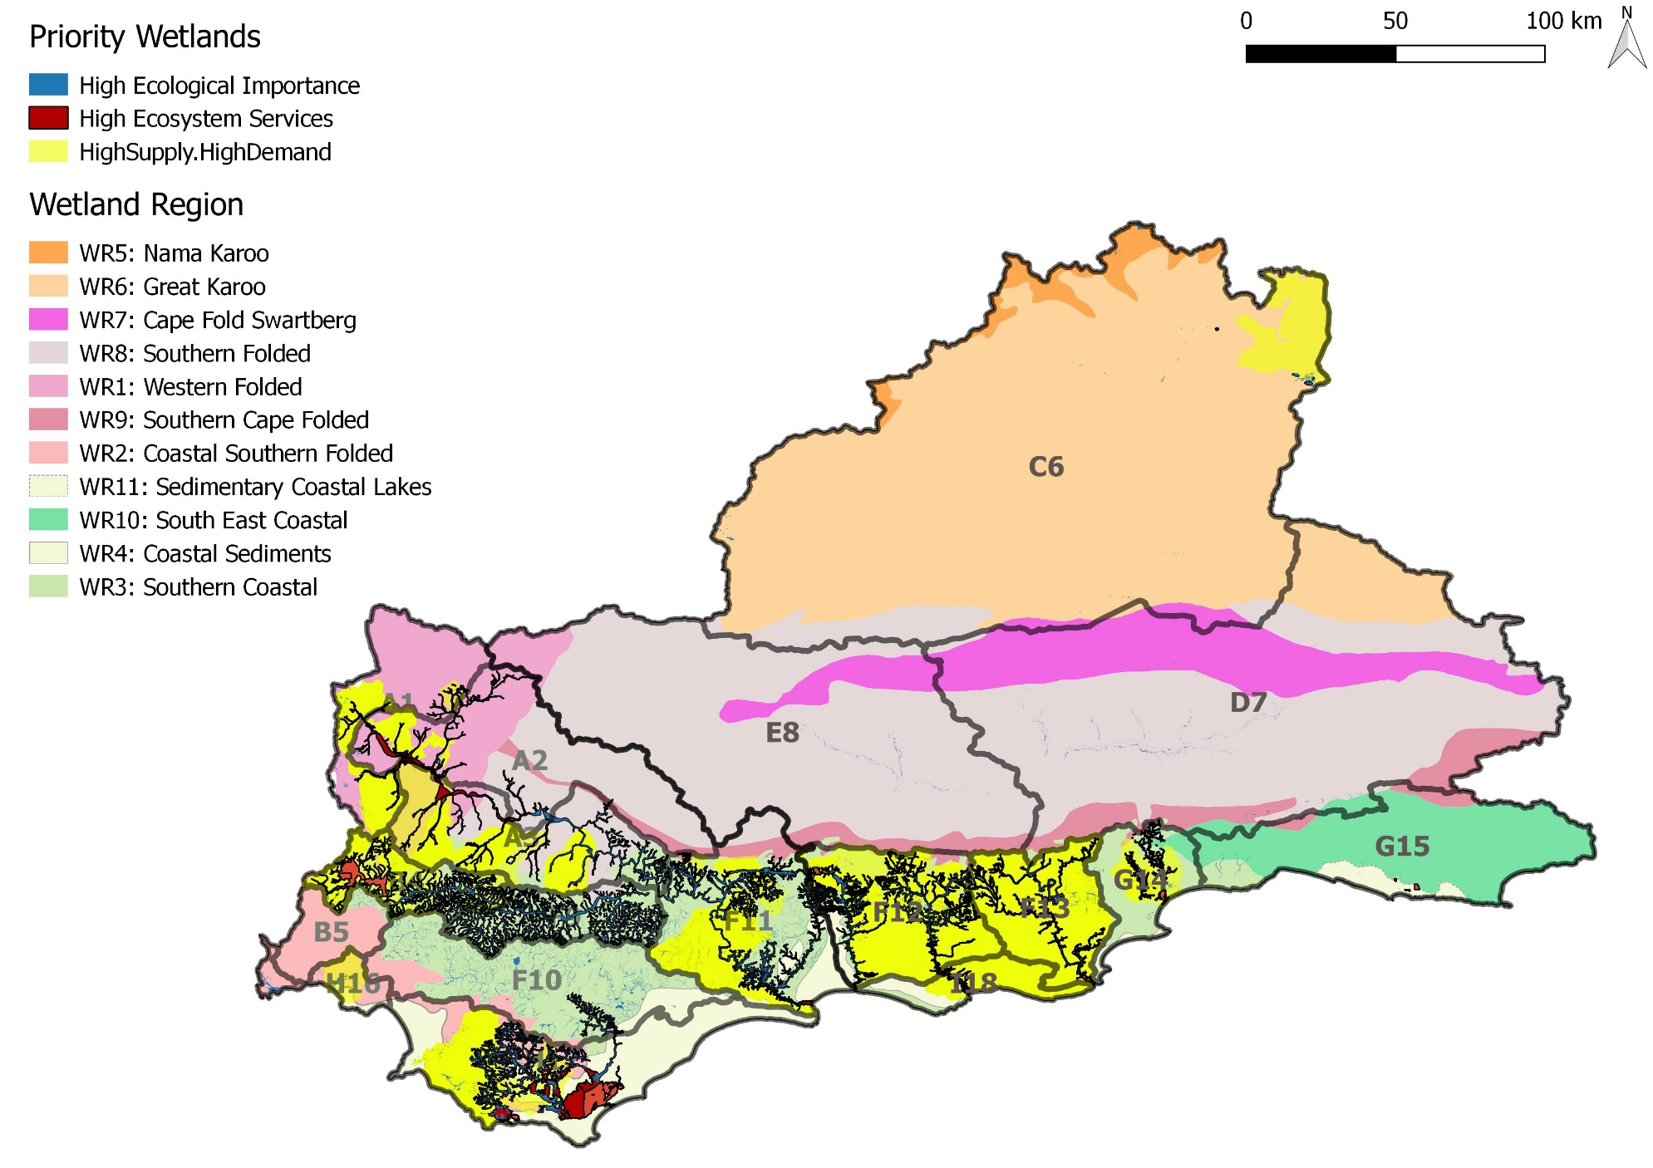

Slide 16
Typical threats to Priority Wetlands
Floodplain wetlands:
  Generally receive most water during high flow events when waters overtop the streambank.
  NB flood attenuation because of the nature of vegetation and topographic setting. Flood attenuation is likely to be high early in the season until the floodplain soils are saturated, whilst in the late season flood attenuation is reduced.
  As flood waters overtop streambanks the waters drop sediments, and nutrient bound sediments, which are left behind to accumulate.
  The nature of clayey soils in floodplains means that soils retain water, thus limiting contribution to streamflow and groundwater recharge.
Indirect impacts: Upstream dams, or dams within wetlands as well as channel straightening and infilling through construction of bridges or through wetland “reclamation” are the greatest impacts in floodplains. Floodplains are generally resilient to changes in sediment inputs as the system is dominated by fluvial processes. The main impact will be when harmful erosion is occurring due to a change in the natural dynamic (i.e. dam upstream removing sediment). Floodplain size, and manner of releasing water back into the wetland is also important.

Slide 17
Typical threats to Priority Wetlands
Identification of Priority Wetlands
Typical threats to Priority Wetlands
Channelled valley-bottom wetlands
Less active deposition than floodplains and tend to be narrower with steeper gradients. Groundwater input to the main stem channel is also generally greater.
Channel straightening and infilling through construction are the greatest impacts. Changes in runoff characteristics and erosional, depositional features and loss of organic material are also important.
Non-channelled valley-bottom wetlands
Stream channel inputs are spread diffusely across the wetland even at low flows, resulting in high levels of soil organic matter. This aids nitrate and toxicant removal, particularly if there is groundwater contribution.
Changes in runoff characteristics through increased stormwater inputs and increased erosional/deposition are important in non channelled wetlands.

Slide 18
Identification of Priority Wetlands
Typical threats to Priority Wetlands
Hillslope seep wetlands
Normally associated with groundwater discharge, although there are additional contributions from surrounding runoff. Contribute streamflow regulation early in the season, until soils are saturated. Good provision of nitrate removal, but poor at erosion control owing to location on steep slopes.
The location on slopes means that hillslope seeps are sensitive to erosion. Habitat transformation through agricultural use is also likely.
Depressions (pans)
Can receive both surface and groundwater flows, which accumulate in the depression.
Flats
Not fed by water from a river channel, and is typically situated on flat land (often on a coastal plain). The primary source of water is precipitation, although on coastal plains groundwater may rise to or near the ground surface. Water typically exits via evapotranspiration and infiltration.
Depression wetlands and Wetland flats are sensitive to increased stormwater inputs as this impacts the seasonality of the wetlands. Habitat transformation is also likely.

Slide 19
Methodology for Determination of RQOs
WETLANDS: RQO outline for wetland in the Breede-Overberg
Notes:
Erik and team to present the methodology used for scenario evaluation

Slide 20
Overview
Water Resource Class
Ecological importance & threat
Prioritisation
EcoSpecs & UserSpecs
RQO Indicators & Numerical Limits
Quantity
Quality
Habitat
Biota
Provision of Ecosystem Services
supply & demand
Available Info
Reserve info
Non-Reserve info

Slide 21
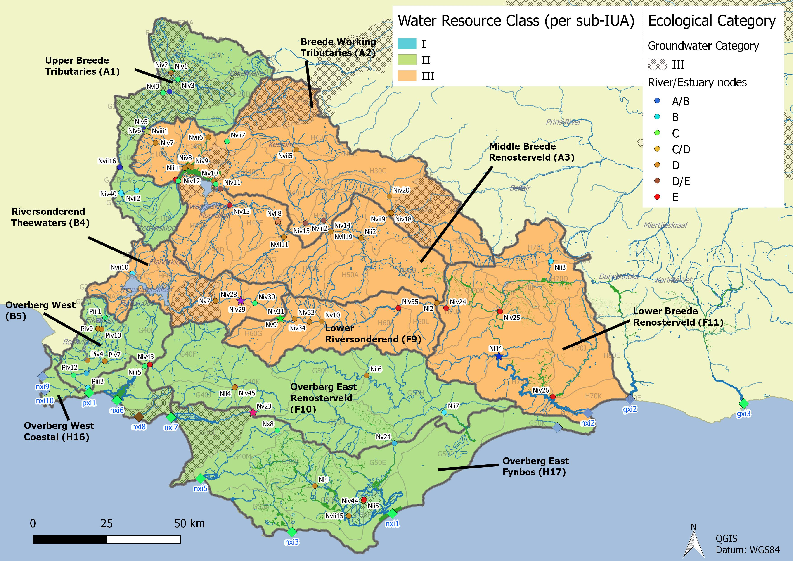
Overview: Water Resource Classification
Integrated Units of Analysis and Nodes

Slide 22
Overview: Water Resource Classification
Breede-Overberg Region
Region | IUA | Spatially targeted
Breede Overberg | A1 Upper Breede Tributaries | II
 | A2 Breede Working Tributaries | III
 | A3 Middle Breede Renosterveld | III
 | B4 Riversonderend Theewaters | III
 | F9 Lower Riversonderend | III
 | B5 Overberg West | II
 | H16 Overberg West Coastal | II
 | F10 Overberg East Renosterveld | II
 | H17 Overberg East Fynbos | II
 | F11 Lower Breede Renosterveld | III

Slide 23
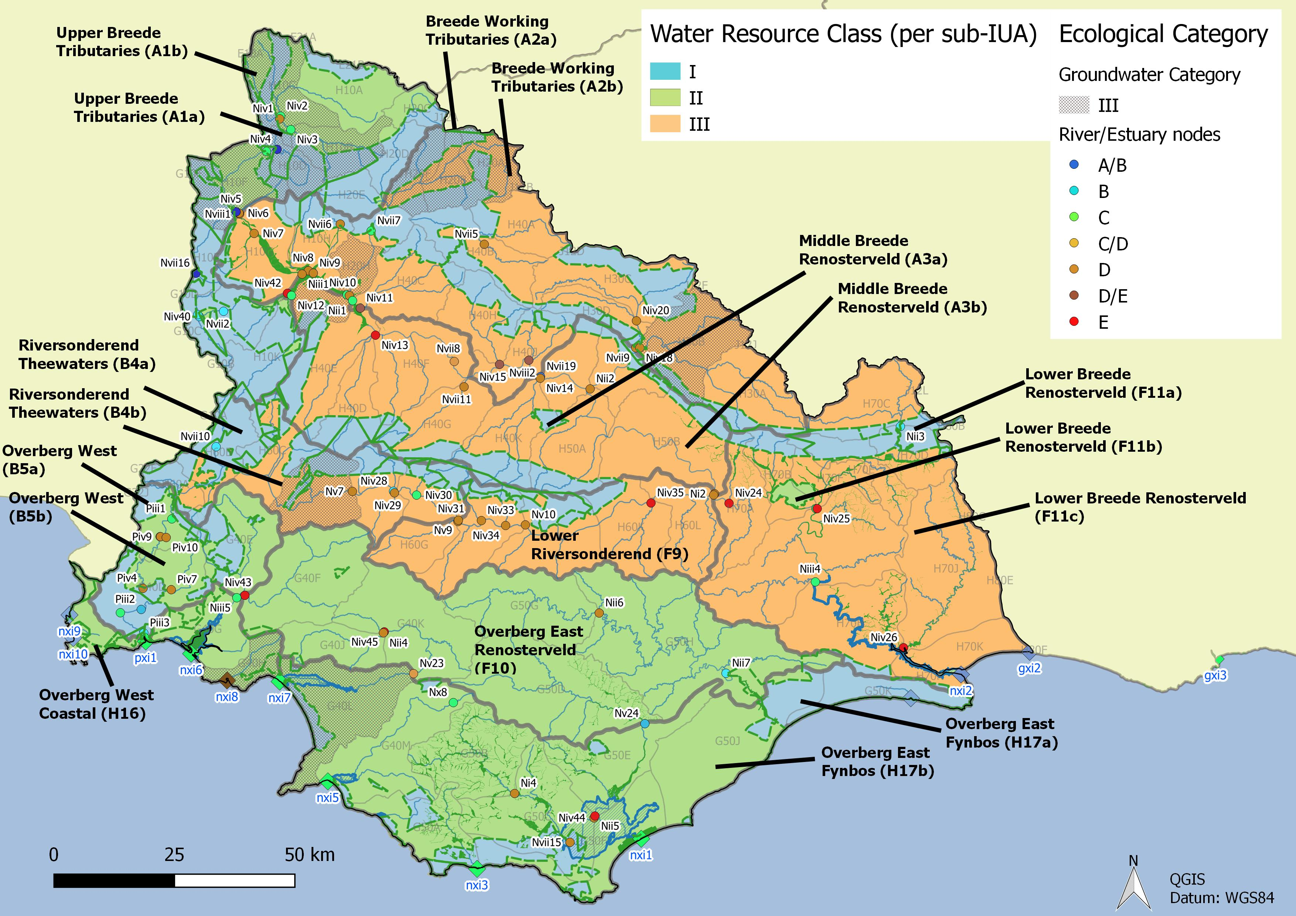
Overview: Management considerations

Slide 24
Overview: available info
Reserve studies are:
A3 Middle Breede Renosterveld Papenkuils Wetland System
Working for Wetlands Program are:
H17 Overberg East Fynbos
  Boesmans River Wetland (Algulhas wetland)
  Upper Ratel River Wetland (Algulhas wetland)
  Pietersieskloof Wetland (Algulhas wetland)
  Bergplaas Wetland (Algulhas wetland)
Malan et al.
A2 Breede Working Tributaries and A3 Middle Breede Renosterveld
  Papenkuils and Platdrif
H16 Overberg East Coastal
  Groot Rondevlei (moderate priority)
  Groot Witvlei (moderate priority)
  Malkopsvlei (moderate priority)
H17 Overberg East Fynbos
  Salmonsdam A
  Nuwejaars River (Algulhas wetlands)
  Groot Hagelkraal River (Algulhas wetlands)
  Algulhas wetlands

Slide 25
Components/Sub-components
Biota: Frogs/Birds
Habitat: Veg/
Geomorphology
Quality: WQ & Sediment
Quantity: Flow/Water retention & distribution
Linkages to Wetland Health Assessment (Macfarlane et al. 2008)

Slide 26
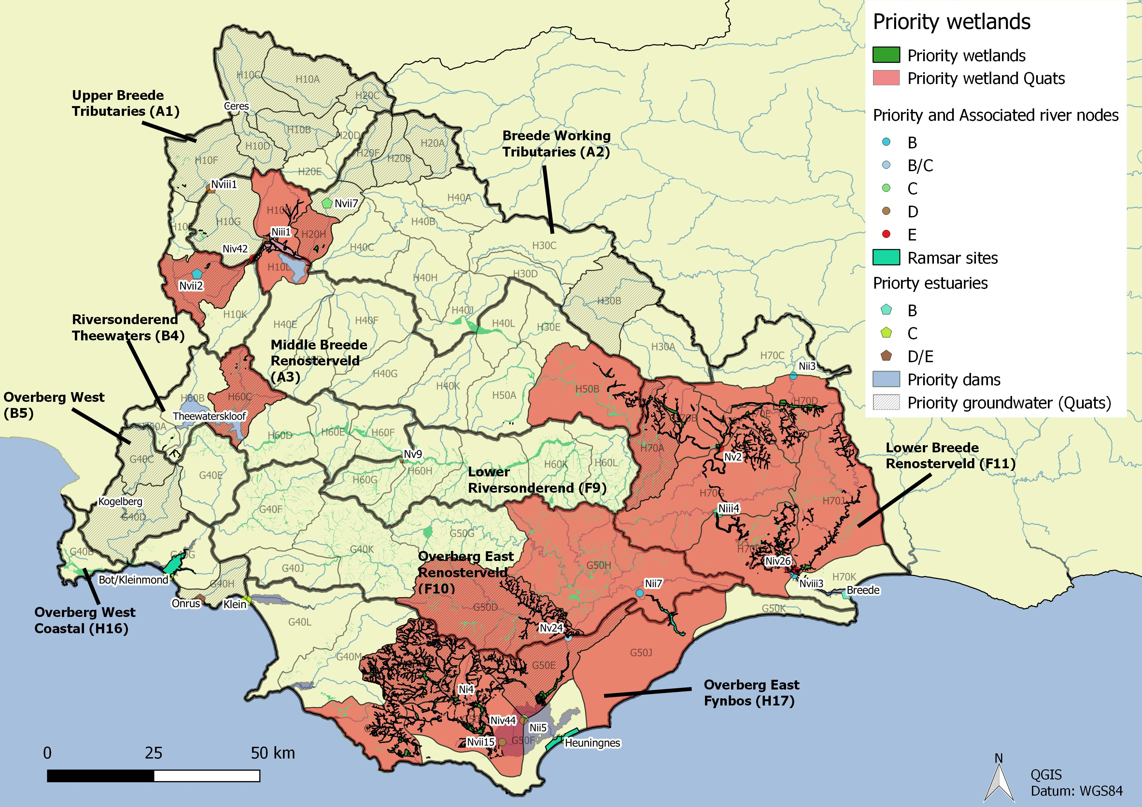

Slide 27
IUA |  |  | NB | Supply | Demand
A1 | WR1 Western Folded | East Coast Shale Renosterveld Floodplain and Channelled Valley Bottom (Molenaars) |  | x | x

Slide 28
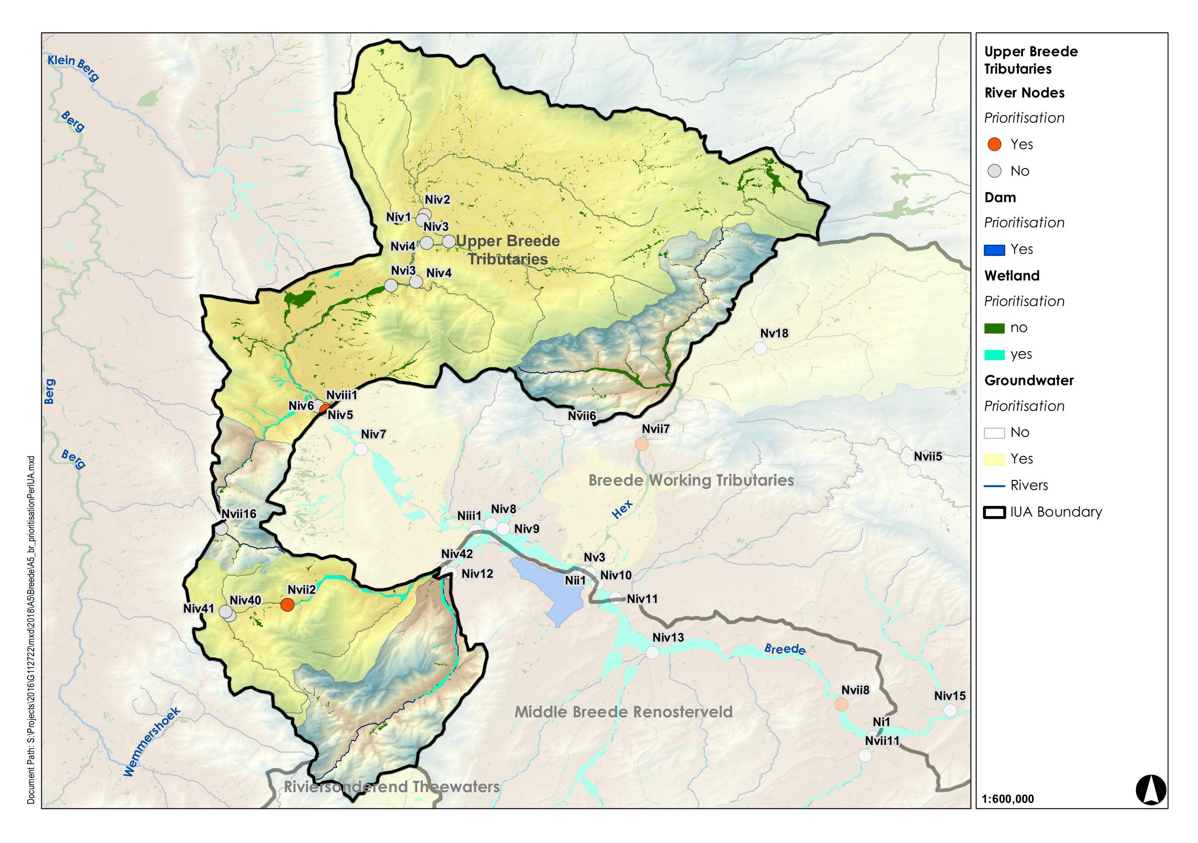
A1: Upper Breede Tributaries
Regulating and Supporting benefits |  |  |  |  |  |  |  | Biodiversity maintenance | Provision Benefits |  |  | Cultural Benefits
Flood attenuation | Streamflow regulation | Water Quality Enhancement
 |  | Sediment trapping | Phosphate assimilation | Nitrate assimilation | Toxicant assimilation | Erosion control | Carbon storage |  | Provision of water for human use | Provision of harvestable resources | Provision of cultivated foods | Cultural heritage | Tourism and recreation | Education
x | x | x | x | x | x | x | x |  |  | x
Wetland Region | Wetland Resource Unit | Priority |  |  | PES | EIS | REC | Quantity |  | Quality |  |  |  |  |  | Indicators selected
 |  | Ecological Importance | Provision of ecosystem services
 |  |  |  |  |  |  |  | Water inputs | Water distribution & retention patterns | Nutrients | Salts | System variables | Toxics | Pathogens | Sediments
 |  |  | Supply | Demand
WR1 Western Folded | East Coast Shale Renosterveld Floodplain and Channelled Valley Bottom |  | x | x | C | - |  | x | x | .x | x | x | x | x | x | Water inputs (Flow)

Slide 29
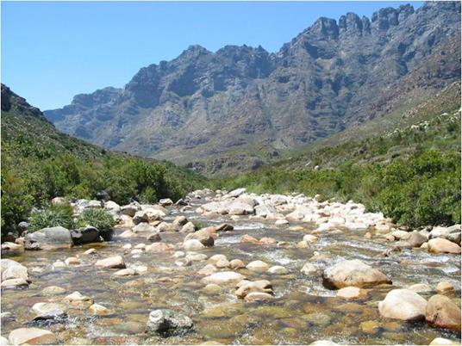
A1: Upper Breede Tributaries
IUA | Spatially targeted
A1 Upper Breede Tributaries | II
Downstream view of Nvii2
Name of Wetland Resource Unit | Component | Sub-component | RQO | Indicator/ measure | Numerical limits
East Coast Shale Renosterveld Floodplain and Channelled Valley Bottom | Quantity | Water inputs (Flow) | Saturation of floodplain vegetation is required. Flows should be such that they do not pose a threat to the nature of the wetland. Flows from Nvii2 (Molenaars) shall be sufficient to maintain the wetland in a condition equal to or better than a B category. | Flow. Wetland hydrology score from the hydrology module of WET-Health (Level 2). | Refer to Nvii2 flows. WET-Health hydrology score of C to be maintained. Repeat every three years and assess and report with a view to assess if there have been any changes in the state of the system

Slide 31
IUA |  |  | NB | Supply | Demand
A2 | WR1 Western Folded | East Coast Shale Renosterveld Floodplain (Papenkuils) |  | x | x

Slide 32
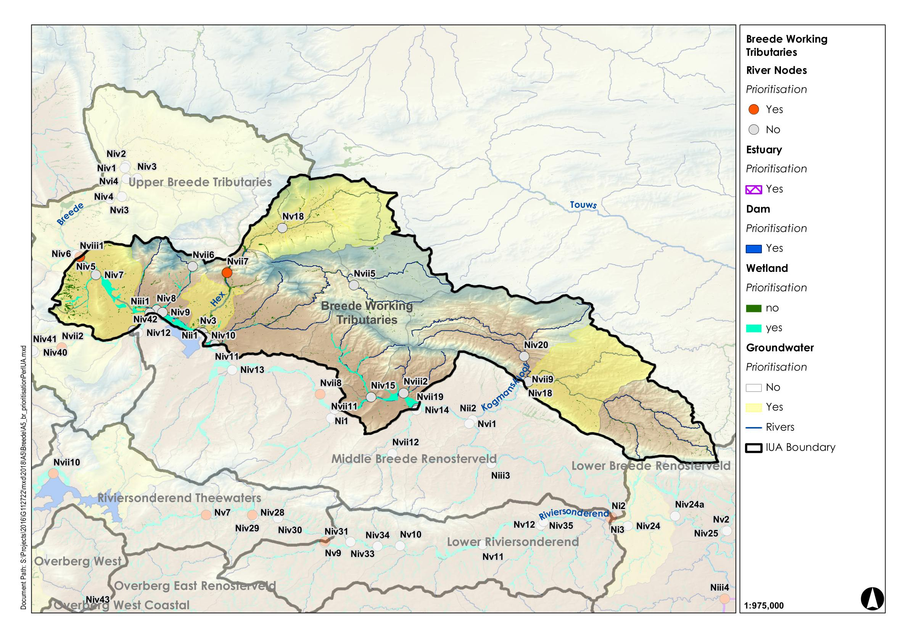
A2: Breede Working Tributaries
Regulating and Supporting benefits |  |  |  |  |  |  |  | Biodiversity maintenance | Provision Benefits |  |  | Cultural Benefits
Flood attenuation | Streamflow regulation | Water Quality Enhancement
 |  | Sediment trapping | Phosphate assimilation | Nitrate assimilation | Toxicant assimilation | Erosion control | Carbon storage |  | Provision of water for human use | Provision of harvestable resources | Provision of cultivated foods | Cultural heritage | Tourism and recreation | Education
x | x | x |  |  |  | x | x |  |  | x
Wetland Resource Unit | Priority |  |  | PES | EIS | REC | Quantity |  | Quality |  |  |  |  |  | Habitat |  |  | Biota |  |  |  |  |  |  |  | Indicators selected
 | Ecological Importance | Provision of ecosystem services
 |  |  |  |  |  |  | Water inputs | Water distribution & retention patterns | Nutrients | Salts | System variables | Toxics | Pathogens | Sediments | Geomorphology |  | Wetland vegetation | Fish | Plant species | Mammals | Birds | Amphibians & reptiles | Periphyton | Aquatic invertebrates | Diatoms
 |  | Supply | Demand
East Coast Shale Renosterveld Floodplain (Papenkuils) |  | x |  | C | High | C | x | x |  |  |  |  |  | x |  | x |  |  |  |  |  |  |  |  |  | Water distribution and retention patterns. And wetland vegetation.

Slide 33
A2: Breede Working Tributaries
IUA | Spatially targeted
A2 Breede Working Tributaries | III
Reserve: Papenkuils
Name of Wetland Resource Unit | Component | Sub-component | RQO | Indicator/ measure | Numerical limits
East Coast Shale Renosterveld Floodplain (Papenkuils) | Quantity | Water distribution and retention patterns. | Saturation is required. Flows should be such that they do not pose a threat to the nature of the wetland. | Flow. Wetland hydrology score from the hydrology module of WET-Health (Level 2). | WET-Health hydrology score of C to be maintained. Papenkuils wetland should be fully flooded (198.97 m amsl) on a minimum of 3 to 5 occasions annually. At least 1 occasion of flooding a year in dry years and 3 to 5 occasions in the remaining years.
 | Habitat | Vegetation | Maintain habitat integrity and vegetation community structure. | Wetland vegetation score from the vegetation module of WET-Health (Level 2). | WET-Health vegetation value of C to be maintained. Repeat every three years and assess and report with a view to assess if there have been any changes in the state of the system.

Slide 35
IUA |  |  | NB | Supply | Demand
A3 | WR3 Southern Coastal | East Coast Shale Renosterveld Floodplain (Breede) | x | x | x

Slide 36
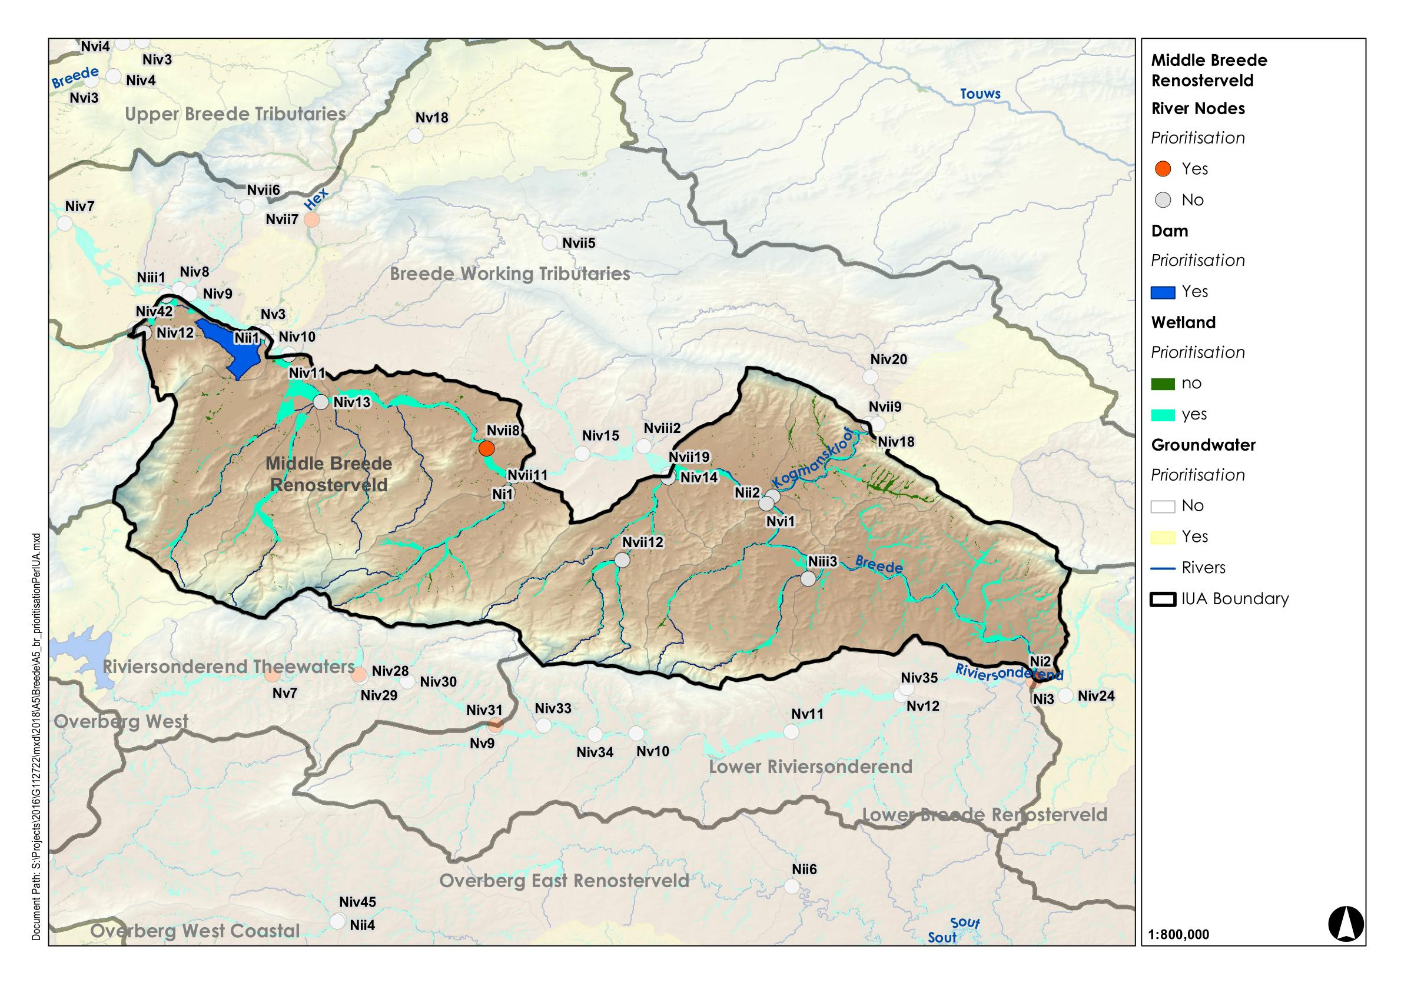
A3: Middle Breede Renosterveld
Regulating and Supporting benefits |  |  |  |  |  |  |  | Biodiversity maintenance | Provision Benefits |  |  | Cultural Benefits
Flood attenuation | Streamflow regulation | Water Quality Enhancement
 |  | Sediment trapping | Phosphate assimilation | Nitrate assimilation | Toxicant assimilation | Erosion control | Carbon storage |  | Provision of water for human use | Provision of harvestable resources | Provision of cultivated foods | Cultural heritage | Tourism and recreation | Education
x | x | x |  |  |  |  |  | x |  |  |  | x
Wetland Region | Wetland Resource Unit | Priority |  |  | PES | EIS | REC | Quantity |  | Habitat |  | Indicators selected
 |  | Ecological Importance | Provision of ecosystem services
 |  |  |  |  |  |  |  | Water inputs | Water distribution & retention patterns | Geomorphology | Wetland vegetation
 |  |  | Supply | Demand
WR8 Southern Folded | East Coast Shale Renosterveld Floodplain (Breede) | x | x | x | C | - | C | x | x |  | x | Water distribution and retention patterns and wetland vegetation.

Slide 37
A3: Middle Breede Renosterveld
IUA | Spatially targeted
A3 Middle Breede Renosterveld | III
Other: Critically endangered vegetation
Name of Wetland Resource Unit | Component | Sub-component | RQO | Indicator/ measure | Numerical limits
East Coast Shale Renosterveld Floodplain (Breede) | Quantity | Water distribution and retention patterns. | Floods are necessary to inundate the floodplain thereby providing wetting regime required for supporting floodplain vegetation. | Water distribution and retention patterns. | WET-Health score of C to be maintained. Compile an accurate desktop basemap for the system prior to the start of monitoring using the most recent satellite imagery and wetland map. At the same time undertake a rapid PES assessment and take fixed point photographs of key features from closest access points. Repeat every 3 years and assess and report on this with a view to assess if there have been any changes in the system.
 | Habitat | Wetland vegetation | Critically endangered wetland vegetation and geomorphology must be maintained or where necessary improved in order to protect the floodplain vegetation. | Wetland vegetation score from the vegetation module of WET-Health (Level 2). | WET-Health vegetation value of C to be maintained. Repeat every three years and assess and report with a view to assess if there have been any changes in the state of the system.

Slide 38
IUA |  |  | NB | Supply | Demand
F11 | WR3 Southern Coastal | East Coast Shale Renosterveld Floodplain (Breede) | x | x

Slide 39
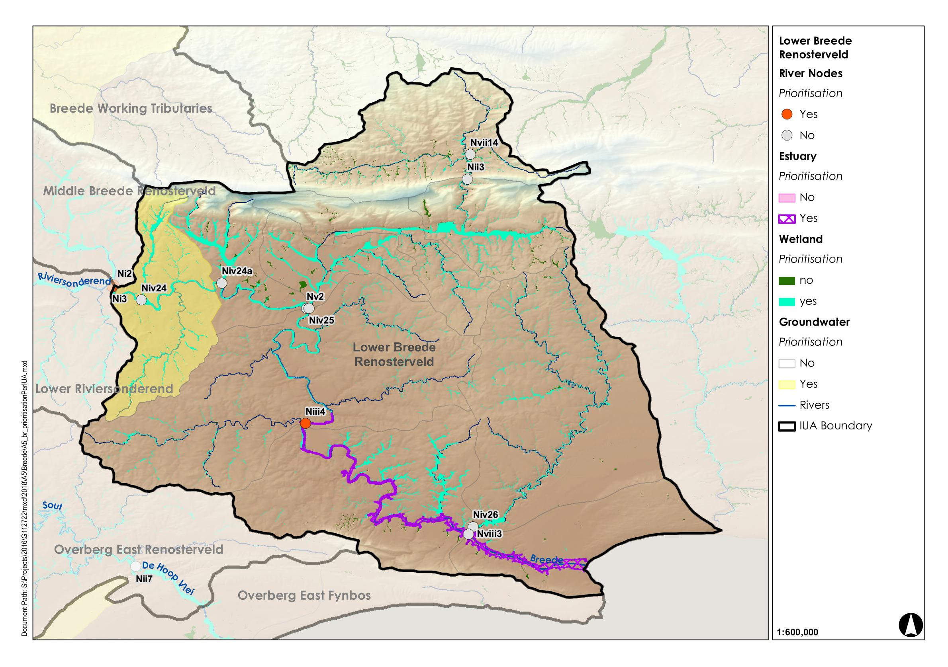
F11: Lower Breede Renosterveld
Regulating and Supporting benefits |  |  |  |  |  |  |  | Biodiversity maintenance | Provision Benefits |  |  | Cultural Benefits
Flood attenuation | Streamflow regulation | Water Quality Enhancement
 |  | Sediment trapping | Phosphate assimilation | Nitrate assimilation | Toxicant assimilation | Erosion control | Carbon storage |  | Provision of water for human use | Provision of harvestable resources | Provision of cultivated foods | Cultural heritage | Tourism and recreation | Education
x | x | x | x | x | x | x | x |  | x | x | x
Wetland Region | Wetland Resource Unit | Priority |  |  | PES | EIS | REC | Quantity |  | Quality |  |  |  |  |  | Indicators selected
 |  | Ecological Importance | Provision of ecosystem services
 |  |  |  |  |  |  |  | Water inputs | Water distribution & retention patterns | Nutrients | Salts | System variables | Toxics | Pathogens | Sediments
 |  |  | Supply | Demand
WR3 Southern Coastal | East Coast Shale Renosterveld Floodplain (Breede) |  | x |  | C | - | C | x | x | .x | x | x | x | x | x | Water distribution and retention patterns and water quality.

Slide 40
F11: Lower Breede Renosterveld
IUA | Spatially targeted
F11 Lower Breede Renosterveld | III
Name of Wetland Resource Unit | Component | Sub-component | RQO | Indicator/ measure | Numerical limits
East Coast Shale Renosterveld Floodplain (Breede) | Quantity | Water distribution and retention patterns. | Saturation is required. Flows should be such that they do not pose a threat to the nature of the wetland. | Water distribution and retention patterns. | Water distribution and retention pattern score as a part of hydrology module in WET-Health.
 | Quality | System variables. | The ecosystem services, in terms of water quality amelioration , provided by the wetland must be managed so as not to undermine the ecological value. | System variables | Sample every three years.

Slide 41
IUA |  |  | NB | Supply | Demand
B4 | WR3 Southern Coastal | East Coast Shale Renosterveld Floodplain (Elands) | x | x | x
 | WR3 Southern Coastal | East Coast Shale Renosterveld Floodplain (Riviersonderend) | x | (x) | (x)

Slide 42
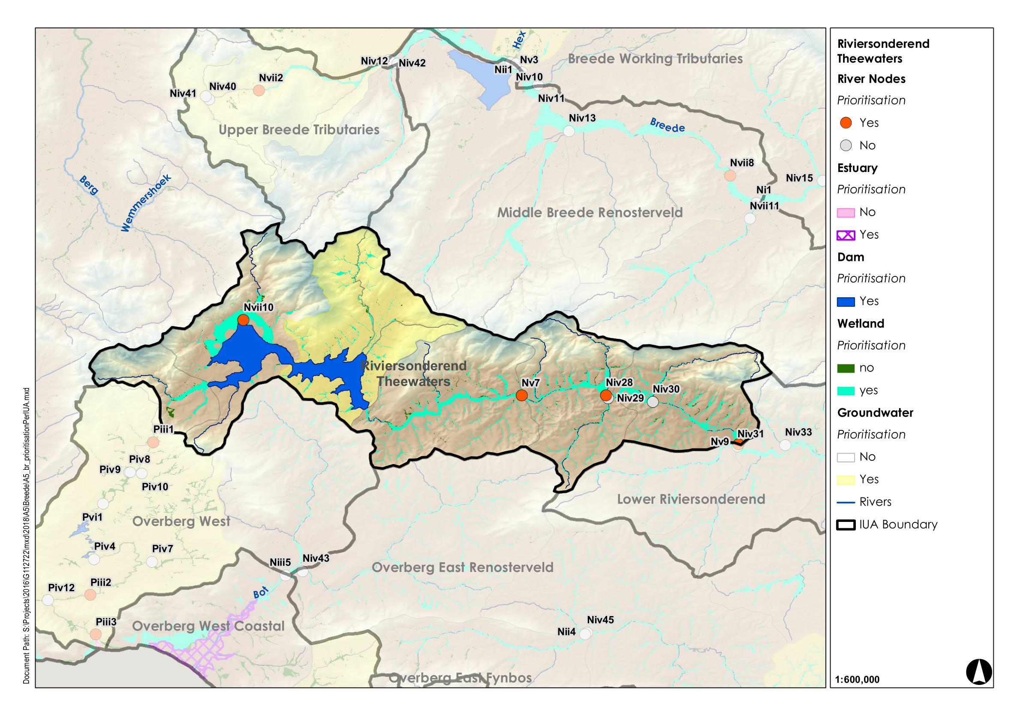
B4: Riviersonderend Thewaters
Regulating and Supporting benefits |  |  |  |  |  |  |  | Biodiversity maintenance | Provision Benefits |  |  | Cultural Benefits
Flood attenuation | Streamflow regulation | Water Quality Enhancement
 |  | Sediment trapping | Phosphate assimilation | Nitrate assimilation | Toxicant assimilation | Erosion control | Carbon storage |  | Provision of water for human use | Provision of harvestable resources | Provision of cultivated foods | Cultural heritage | Tourism and recreation | Education
 |  | x |  |  |  |  |  | x
Wetland Region | Wetland Resource Unit | Priority |  |  | PES | EIS | REC | Quantity |  | Quality |  |  |  |  |  | Habitat |  | Indicators selected
 |  | Ecological Importance | Provision of ecosystem services
 |  |  |  |  |  |  |  | Water inputs | Water distribution & retention patterns | Nutrients | Salts | System variables | Toxics | Pathogens | Sediments | Geomorphology | Wetland vegetation
 |  |  | Supply | Demand
WR1 Western Folded | East Coast Shale Renosterveld Floodplain (Elands) | x | x | x |  |  |  | x | x |  |  |  |  |  | x |  | x | Water distribution and retention patterns. Wetland vegetation.
WR3 Southern Coastal | East Coast Shale Renosterveld Floodplain (Riviersonderend) | x | x | x | C | - | C | x | x |  |  |  |  |  | x |  | x | Water distribution and retention patterns. Wetland vegetation.

Slide 43
B4: Riviersonderend Thewaters
IUA | Spatially targeted
B4 Riviersonderend Thewaters | III
Other: Critically endangered vegetation
Name of Wetland Resource Unit | Component | Sub-component | RQO | Indicator/ measure | Numerical limits
East Coast Shale Renosterveld Floodplain (Elands) | Quality | Sediment storage | The ecosystem services, in terms of sediment retention, provided by the wetland must be managed so as not to undermine the ecological value. | Wetland geomorphology score from the geomorphology module of WET-Health (Level 2). | WET-Health vegetation value of C to be maintained. Repeat every three years and assess and report with a view to assess if there have been any changes in the state of the system
 | Habitat | Wetland vegetation. | Critically endangered wetland vegetation and geomorphology must be maintained or where necessary improved in order to protect the floodplain vegetation. | Wetland vegetation score from the vegetation module of WET-Health (Level 2). | WET-Health vegetation value of C to be maintained. Repeat every three years and assess and report with a view to assess if there have been any changes in the state of the system.
East Coast Shale Renosterveld Floodplain (Riviersonderend) | Habitat | Wetland vegetation. | Critically endangered wetland vegetation and geomorphology must be maintained or where necessary improved in order to protect the floodplain vegetation. | Wetland vegetation score from the vegetation module of WET-Health (Level 2). | WET-Health vegetation value of C to be maintained. Repeat every three years and assess and report with a view to assess if there have been any changes in the state of the system.

Slide 44
IUA |  |  | NB | Supply | Demand
F9 | WR3 Southern Coastal | East Coast Shale Renosterveld Floodplain (Riviersonderend) | x | (x) | (x)

Slide 45
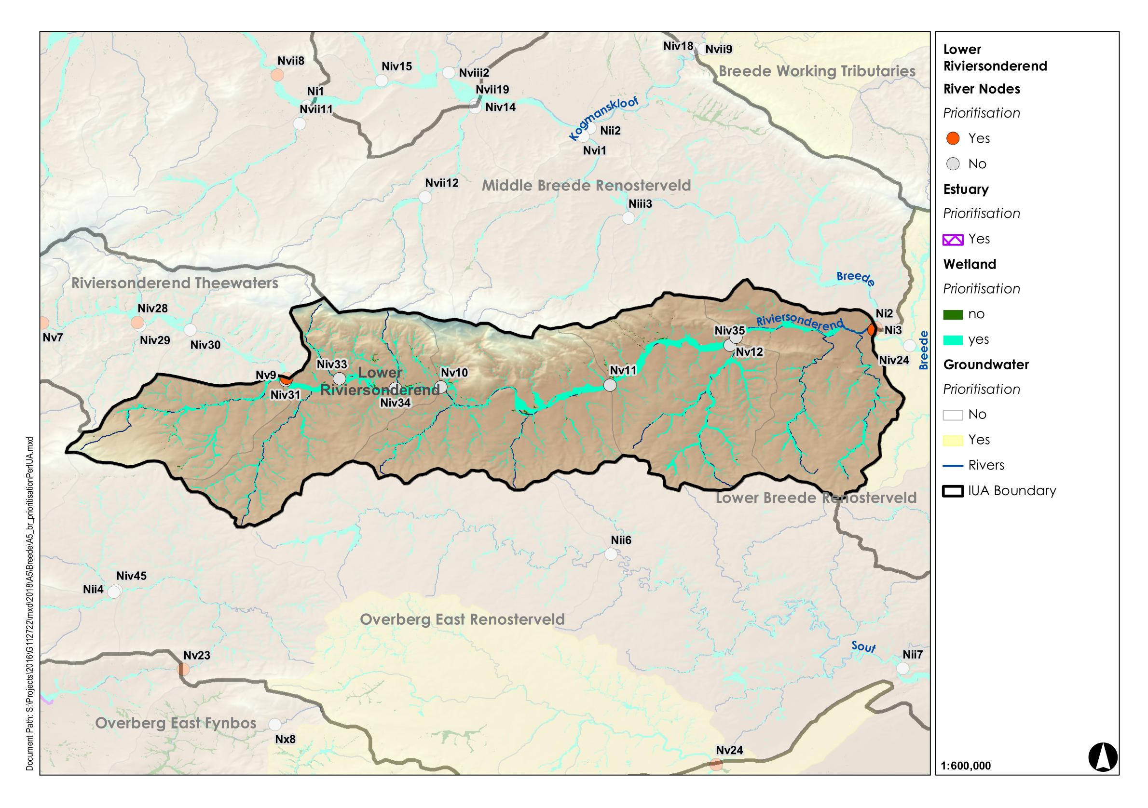
F9: Lower Riviersonderend
Regulating and Supporting benefits |  |  |  |  |  |  |  | Biodiversity maintenance | Provision Benefits |  |  | Cultural Benefits
Flood attenuation | Streamflow regulation | Water Quality Enhancement
 |  | Sediment trapping | Phosphate assimilation | Nitrate assimilation | Toxicant assimilation | Erosion control | Carbon storage |  | Provision of water for human use | Provision of harvestable resources | Provision of cultivated foods | Cultural heritage | Tourism and recreation | Education
x | x | x |  |  |  |  |  | x
Wetland Region | Wetland Resource Unit | Priority |  |  | PES | EIS | REC | Quantity |  | Quality |  |  |  |  |  | Habitat |  | Indicators selected
 |  | Ecological Importance | Provision of ecosystem services
 |  |  |  |  |  |  |  | Water inputs | Water distribution & retention patterns | Nutrients | Salts | System variables | Toxics | Pathogens | Sediments | Geomorphology | Wetland vegetation
 |  |  | Supply | Demand
WR3 Southern Coastal | East Coast Shale Renosterveld Floodplain (Riviersonderend) | x | x |  |  |  |  | x | x |  |  |  |  |  | x |  | x | Water distribution and retention patterns. Wetland vegetation.

Slide 46
F9: Lower Riviersonderend
IUA | Spatially targeted
F9 Lower Riviersonderend | III
Other: Critically endangered vegetation
Name of Wetland Resource Unit | Component | Sub-component | RQO | Indicator/ measure | Numerical limits
East Coast Shale Renosterveld Floodplain (Riviersonderend) | Quantity | Water distribution and retention patterns. | Floods are necessary to inundate the floodplain thereby providing wetting regime required for supporting floodplain vegetation. | Water distribution and retention patterns. | Compile an accurate desktop basemap for the system prior to the start of monitoring using the most recent satellite imagery and wetland map.
 |  |  |  |  | At the same time undertake a rapid PES assessment and take fixed point photographs of key features from closest access points.
 |  |  |  |  | Repeat every 3 years and assess and report on this with a view to assess if there have been any changes in the system.
 | Quality | Sediment storage | The ecosystem services, in terms of sediment retention, provided by the wetland must be managed so as not to undermine the ecological value. | Wetland geomorphology score from the geomorphology module of WET-Health (Level 2). | Repeat every 3 years and assess and report on this with a view to assess if there have been any changes in the system.
 | Habitat | Wetland vegetation. | Critically endangered wetland vegetation and geomorphology must be maintained or where necessary improved in order to protect the floodplain vegetation. | Wetland vegetation score from the vegetation module of WET-Health (Level 2). | WET-Health vegetation value of C to be maintained. Repeat every three years and assess and report with a view to assess if there have been any changes in the state of the system.

Slide 47
IUA |  |  | NB | Supply | Demand
F10 | WR8 Southern Coastal | Southwest Ferricrete Fynbos Floodplain (Kars) | x | x

Slide 48
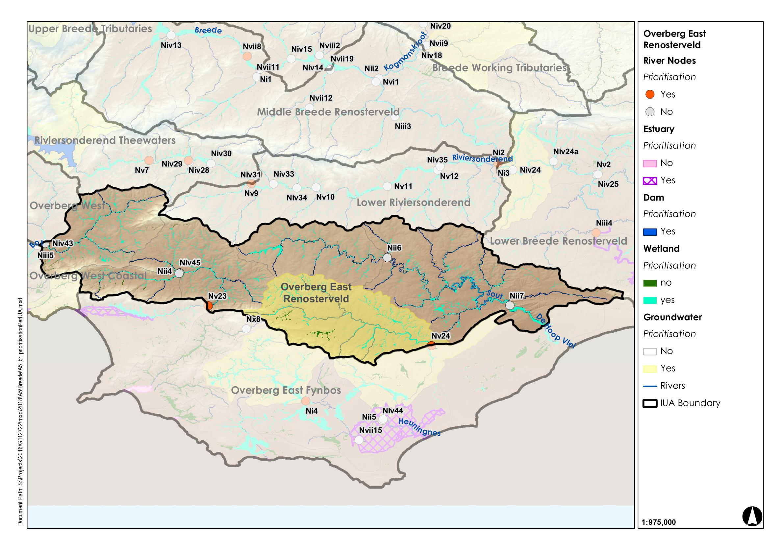
F10: Overberg East Renosterveld
Regulating and Supporting benefits |  |  |  |  |  |  |  | Biodiversity maintenance | Provision Benefits |  |  | Cultural Benefits
Flood attenuation | Streamflow regulation | Water Quality Enhancement
 |  | Sediment trapping | Phosphate assimilation | Nitrate assimilation | Toxicant assimilation | Erosion control | Carbon storage |  | Provision of water for human use | Provision of harvestable resources | Provision of cultivated foods | Cultural heritage | Tourism and recreation | Education
x | x | x |  |  |  |  |  | x |  | x | x
Wetland Region | Wetland Resource Unit | Priority |  |  | PES | EIS | REC | Quantity |  | Quality |  |  |  |  |  | Habitat |  |  | Biota |  |  |  |  |  |  |  | Indicators selected
 |  | Ecological Importance | Provision of ecosystem services
 |  |  |  |  |  |  |  | Water inputs | Water distribution & retention patterns | Nutrients | Salts | System variables | Toxics | Pathogens | Sediments | Geomorphology |  | Wetland vegetation | Fish | Plant species | Mammals | Birds | Amphibians & reptiles | Periphyton | Aquatic invertebrates | Diatoms
 |  |  | Supply | Demand
WR8 Southern Coastal | Southwest Ferricrete Fynbos Floodplain (Kars) | x | x |  | C | - | C | x | x |  |  |  |  |  | x |  | x |  |  |  |  |  | x |  |  |  | Water distribution and retention patterns. Wetland vegetation and frogs.

Slide 49
F10: Overberg East Renosterveld
IUA | Spatially targeted
F10 Overberg East Renosterveld | II
Other: Critically endangered vegetation and NFEPA Fish
Name of Wetland Resource Unit | Component | Sub-component | RQO | Indicator/ measure | Numerical limits
Southwest Ferricrete Fynbos Floodplain (Kars) | Quality | Sediment storage | The ecosystem services, in terms of sediment retention, provided by the wetland must be managed so as not to undermine the ecological value. | Wetland geomorphology score from the geomorphology module of WET-Health (Level 2). | Repeat every 3 years and assess and report on this with a view to assess if there have been any changes in the system.
 | Habitat | Wetland vegetation. | Critically endangered wetland vegetation and geomorphology must be maintained or where necessary improved in order to protect the floodplain vegetation. | Wetland vegetation score from the vegetation module of WET-Health (Level 2). | WET-Health vegetation value of C to be maintained. Repeat every three years and assess and report with a view to assess if there have been any changes in the state of the system.
 | Biota | Frogs | Populations of frog must be maintained at least at current levels to meet conservation targets. | TBD | TBD

Slide 50
IUA |  |  | NB | Supply | Demand
H17 | WR4 Coastal Sediments | Southwest Ferricrete Fynbos Flat, Depression and Floodplain | x | x | x
 |  | East Coast Shale Renosterveld Floodplain (De Hoop vlei) | x

Slide 51
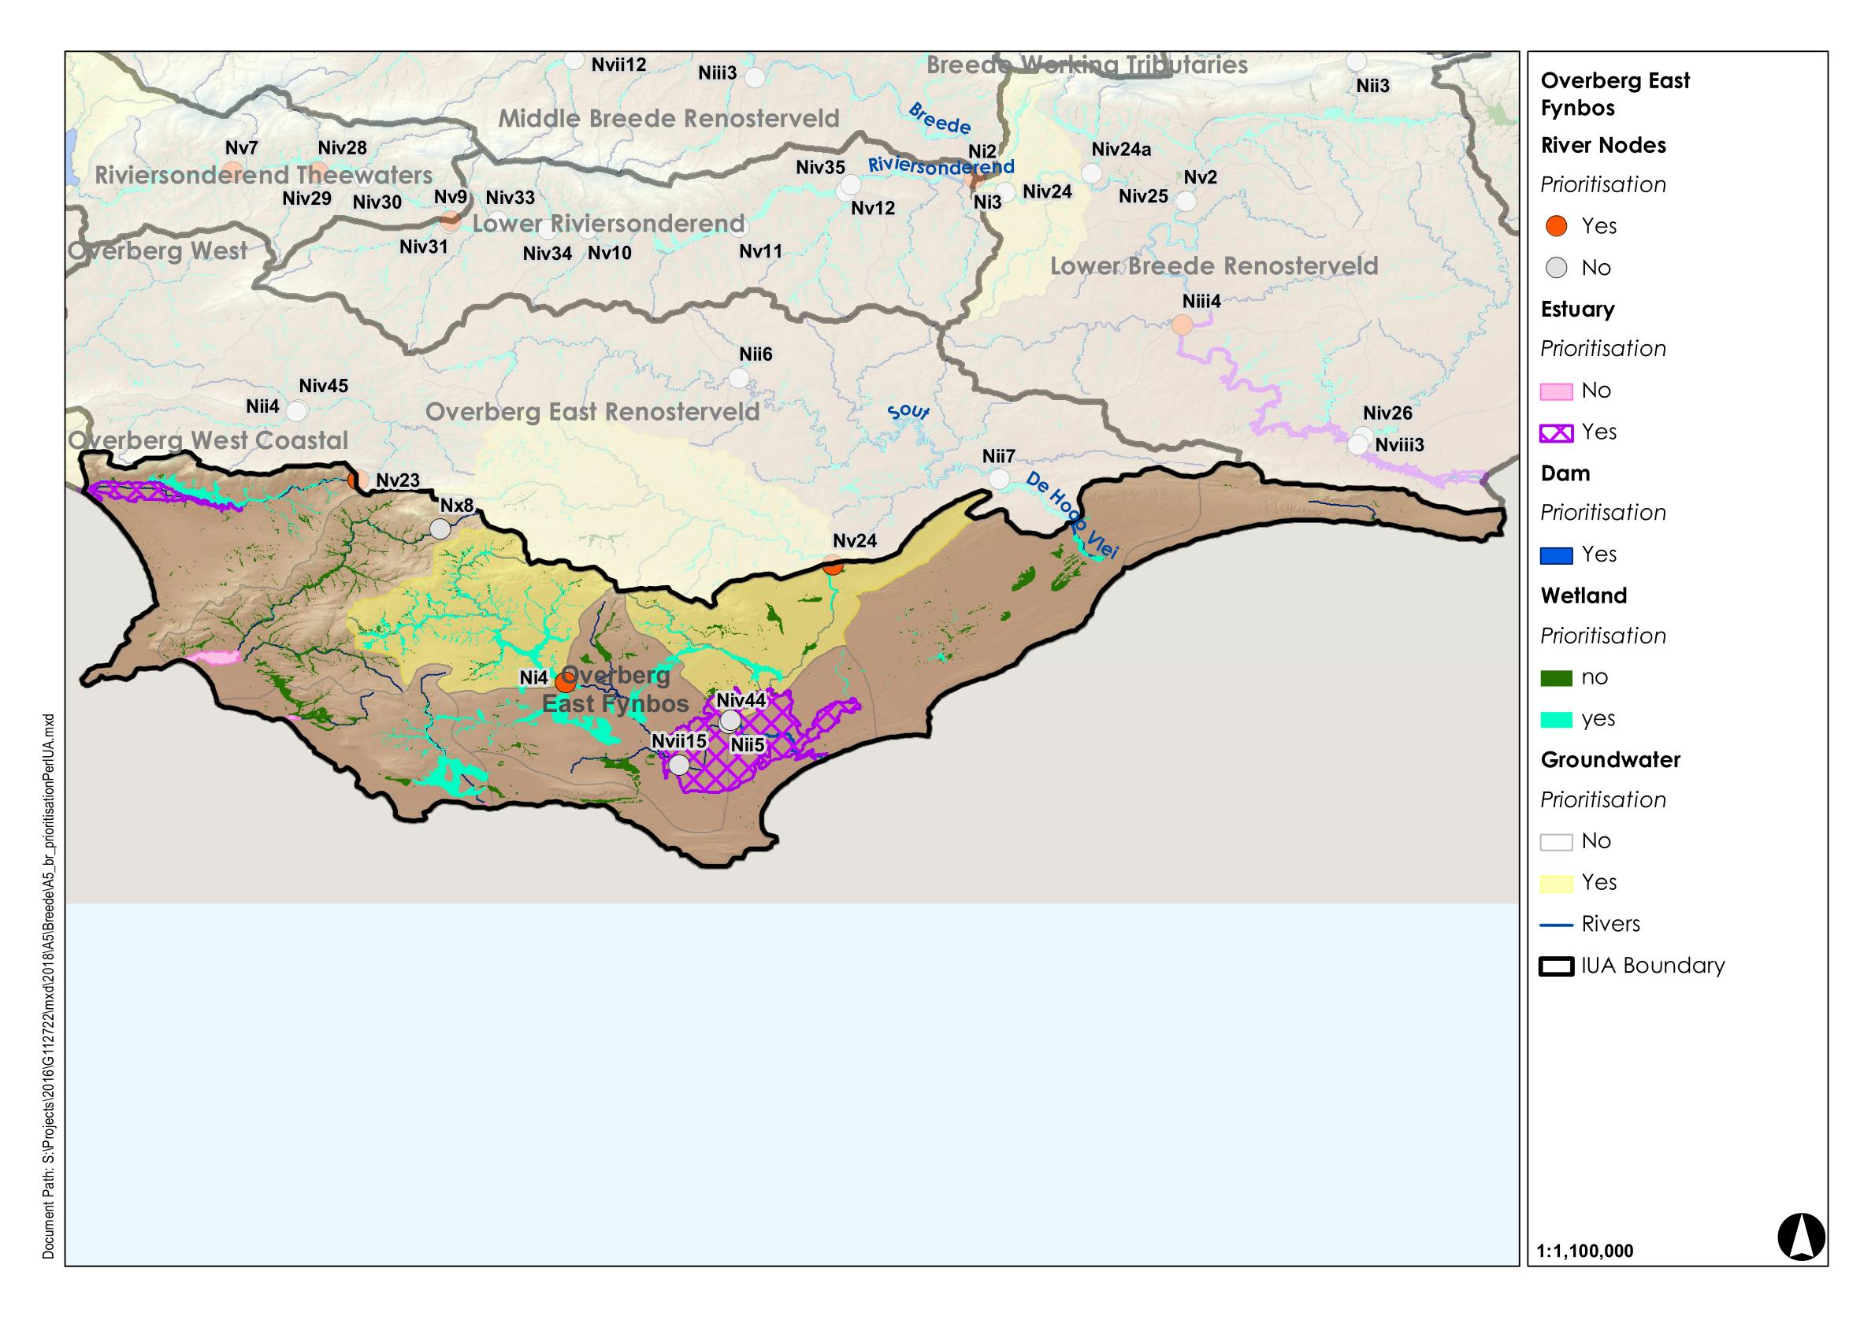
H17: Overberg East Fynbos
Regulating and Supporting benefits |  |  |  |  |  |  |  | Biodiversity maintenance | Provision Benefits |  |  | Cultural Benefits
Flood attenuation | Streamflow regulation | Water Quality Enhancement
 |  | Sediment trapping | Phosphate assimilation | Nitrate assimilation | Toxicant assimilation | Erosion control | Carbon storage |  | Provision of water for human use | Provision of harvestable resources | Provision of cultivated foods | Cultural heritage | Tourism and recreation | Education
x | x | x | x | x | x | x | x | x | x | x | x | x | x | x
 |  |  |  |  |  |  |  | x |  |  |  | x | x | x
Wetland Region | Wetland Resource Unit | Priority |  |  | PES | EIS | REC | Quantity |  | Quality |  |  |  |  |  | Habitat |  |  | Biota |  |  |  |  |  |  |  | Indicators selected
 |  | Ecological Importance | Provision of ecosystem services
 |  |  |  |  |  |  |  | Water inputs | Water distribution & retention patterns | Nutrients | Salts | System variables | Toxics | Pathogens | Sediments | Geomorphology |  | Wetland vegetation | Fish | Plant species | Mammals | Birds | Amphibians & reptiles | Periphyton | Aquatic invertebrates | Diatoms
 |  |  | Supply | Demand
WR4 Coastal Sediments | Southwest Ferricrete Fynbos Flat, Depression and Floodplain (Algulhas) | x | x | x | C/D | V High | C/D | x | x | x | x | x | x | x | x |  | x |  |  |  |  |  | x |  |  |  | Water distribution and retention patterns. Wetland vegetation and frogs.
 | East Coast Shale Renosterveld Floodplain (De Hoop Vlei) | x |  |  | C | High | C |  |  |  |  |  |  |  |  |  | x |  |  |  |  | x |  |  |  |  | Wetland habitat from Ramsar conditions.

Slide 52
H17: Overberg East Fynbos
IUA | Spatially targeted
H17 Overberg East Fynbos | II
Other: Critically endangered vegetation; Working for Wetlands, Malan et al. 2015

Slide 53
H17: Overberg East Fynbos
Name of Wetland Resource Unit | Component | Sub-component | RQO | Indicator/ measure | Numerical limits
Southwest Ferricrete Fynbos Flat, Depression and Floodplain (Algulhas) | Quantity | Water distribution and retention patterns. | Floods are necessary to inundate the floodplain thereby providing wetting regime required for supporting floodplain vegetation. | Water distribution and retention patterns. | Compile an accurate desktop basemap for the system prior to the start of monitoring using the most recent satellite imagery and wetland map.
 |  |  | Flat and depression wetlands require inputs from surrounding runoff, and interflow, in order to provide wetting regime required for supporting wetland vegetation. |  | At the same time undertake a rapid PES assessment and take fixed point photographs of key features from closest access points.
 |  |  |  |  | Repeat every 3 years and assess and report on this with a view to assess if there have been any changes in the system.
 | Quality | Sediment storage | The ecosystem services, in terms of sediment retention, provided by the wetland must be managed so as not to undermine the ecological value. | Wetland geomorphology score from the geomorphology module of WET-Health (Level 2). | Repeat every 3 years and assess and report on this with a view to assess if there have been any changes in the system.
 | Habitat | Wetland vegetation. | Critically endangered wetland vegetation and geomorphology must be maintained or where necessary improved in order to protect the wetland vegetation. | Wetland vegetation score from the vegetation module of WET-Health (Level 2). | WET-Health vegetation value of C to be maintained. Repeat every three years and assess and report with a view to assess if there have been any changes in the state of the system.
 | Biota | Frogs | Populations of frog must be maintained at least at current levels to meet conservation targets. | Wetland Resource Unit is a NFEPA Frog Priority wetland but is not protected (although a portion is within the Alguhas National Park). Management of the wetland is required in order to maintain a viable population of frog species. | TBD
East Coast Shale Renosterveld Floodplain (De Hoop Vlei) | Habitat | Wetland vegetation. | Critically endangered wetland vegetation and geomorphology must be maintained or where necessary improved in order to protect the vegetation surrounding the Ramsar site. | Wetland vegetation score from the vegetation module of WET-Health (Level 2). | WET-Health vegetation value of C to be maintained. Repeat every three years and assess and report with a view to assess if there have been any changes in the state of the system.
 | Biota | Birds | Populations of Pelecanus onocrotalus, Ixobrychus minutus, Ciconia ngra, Phoenicopterus ruber, Phonicopterus minor, Hydroprogne caspia, Charadrius pallidrus must be maintained at least at current levels to meet conservation targets. | Number of observed Pelecanus onocrotalus, Ixobrychus minutus, Ciconia ngra, Phoenicopterus ruber, Phonicopterus minor, Hydroprogne caspia, Charadrius pallidrus present annually. Reporting Rate, or total numbers counted annually*. | TBD

